Slide 1
Trees

Slide 2
Content
Introduction to Trees.
Introduction to Binary Trees.
Traversing Binary Trees.
Introduction to Binary Search Trees.
Insertion into Binary Search Trees.
Huffman Algorithm for Data Encoding.

Slide 3
Introduction to Trees
A Tree is a finite set of elements called nodes such that:
There is specially designated node called the root.
The remaining nodes are partitioned into disjoint sets T₁,….T_{n} where each of these sets is also tree called sub trees of the root.
Each node can have 0 or more children.
A node can have at most one parent.
A
B
C
D
E
F
G

Slide 4
Introduction to Binary Trees
Each node can have a maximum of two children.
A binary tree has the benefits of both an ordered array and a linked list as search is as quick as in a sorted array and insertion or deletion operation are as fast as in linked list.
A binary tree T is a finite set of elements, called nodes such that:
(a) T is empty (called null or empty tree) or
(b) T contains a distinguished node R, called the root of T, and the remaining nodes of T form an ordered pair of disjoint binary trees T₁ and T₂.
A
B
C
D
E
F
G

Slide 5
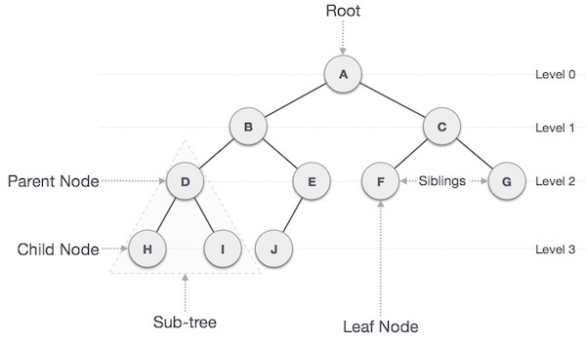
Introduction to Binary Trees

Slide 6
Traversing Binary Trees
There are three standard ways of traversing a binary tree T with root R are,
Preorder
Process the root R.
Traverse the left subtree of R in preorder.
Traverse the right subtree of R in preorder.
A
A
A
B
C
B
C
B
C
D
E
F
G
D
E
F
G
D
E
F
G

Slide 7
Traversing Binary Trees
Preorder: A B D E C F G
A
A
A
B
C
B
C
B
C
D
E
F
G
D
E
F
G
D
E
F
G
A
B
C
D
E
F
G

Slide 8
Traversing Binary Trees
Inorder
Traverse the left subtree of R in inorder.
Process the root R.
Traverse the right subtree of R in inorder.
A
A
A
B
C
B
C
B
C
D
E
F
G
D
E
F
G
D
E
F
G

Slide 9
Traversing Binary Trees
Inorder: D B E A F C G
A
A
A
B
C
B
C
B
C
D
E
F
G
D
E
F
G
D
E
F
G
A
B
C
D
E
F
G

Slide 10
Traversing Binary Trees
Postorder
Traverse the left subtree of R in postorder.
Traverse the right subtree of R in postorder.
Process the root R.
A
A
A
B
C
B
C
B
C
D
E
F
G
D
E
F
G
D
E
F
G

Slide 11
Traversing Binary Trees
Postorder: D E B F G C A
A
A
A
B
C
B
C
B
C
D
E
F
G
D
E
F
G
D
E
F
G
A
B
C
D
E
F
G

Slide 12
Introduction to Binary Search Trees
A binary search tree T is a binary tree in which each node N of T has the following property,
a) The value at N is greater than every value in the left subtree of N.
b) The value at N is less than every value in the right subtree of N.
40
30
50
25
35
45
60

Slide 13
Insertion into Binary Search Trees
Suppose we are given following items to insert on a empty Binary Search Tree(BST),
40, 60, 50, 33, 55, 11
Step 1: Step 2:
Item=40 Item=60
Step 3: Step 4:
Item=50 Item=33
40
40
60
40
40
60
33
60
50
50

Slide 14
Insertion into Binary Search Trees
Step 5:
Item=55
Step 6:
Item=11
40
33
60
50
40
55
33
60
11
50
55

Slide 15
Huffman Algorithm
Huffman coding is a lossless data compression algorithm.
In this algorithm, a variable-length code is assigned to input different characters.
The code length is related to how frequently characters are used.
Most frequent characters have the smallest codes and longer codes for least frequent characters.

Slide 16
Huffman Algorithm for Data Encoding
Bit(C1)=16*3+5*3+12*3+17*3+10*3+25*3=255
Bit(C2)=16*2+5*4+12*3+17*2+10*4+25*2=212
Character | Frequency | Fixed Length(C1) | Huffman(C2)
A | 16 | 000 | 00
B | 5 | 001 | 1100
C | 12 | 010 | 110
D | 17 | 011 | 01
E | 10 | 100 | 1111
F | 25 | 101 | 10

Slide 17
Huffman Algorithm for Data Encoding
Step 1:
B: 5
E: 10
C: 12
A: 16
D: 17
F: 25
15
C: 12
A: 16
D: 17
F: 25
0
1
B: 5
E: 10

Slide 18
Huffman Algorithm for Data Encoding
Step 2:
27
A: 16
D: 17
F: 25
0
1
C: 12
15
0
1
B: 5
E: 10

Slide 19
Huffman Algorithm for Data Encoding
Step 3:
27
33
F: 25
0
1
0
1
C: 12
15
A: 16
D: 17
0
1
B: 5
E: 10

Slide 20
Huffman Algorithm for Data Encoding
Step 4:
33
52
0
1
0
1
F: 25
27
A: 16
D: 17
0
1
C: 12
15
0
1
B: 5
E: 10

Slide 21
Huffman Algorithm for Data Encoding
Step 5:
85
0
1
33
52
0
1
0
1
A: 16
D: 17
F: 25
27
0
1
C: 12
15
0
1
B: 5
E: 10

Slide 22
Thanks

